Slide 1
Final Report
Author Recognition

Slide 2
Terminology
deg_obs: determines by how much the probability of missing the intended key on the keyboard decreases when the miss distance increases
deg_tran: determines by how much the probability of skipping 1 or more letters in the intended word decreases when the number of skipped letters increases
p_iter: probability that the author will repeat the letter just typed
p_mode: probability that the author will type the correct key for any letter

Slide 3
Terminology (cont.)
md: Manhattan Distance
RNT: RoadNotTaken.txt

Slide 4
Experimental Settings
Author Parameters:
deg_obs = [1.5, 2, 3]
deg_tran = [2, 3, 4]
p_iter = [0.1, 0.4, 0.7]
p_mode = [0.3, 0.6, 0.9]
Experiment Parameters:
Vocab. size = [94, 8, 1]
Words typed = [10, 30, 50]
% correct predictions in top 1, top 3, and top 5 most likely authors

Slide 5
Vocabularies

Slide 6
RoadNotTaken.txt
Unique words: 94
Source: “The Road Not Taken” (Robert Frost)

Slide 7
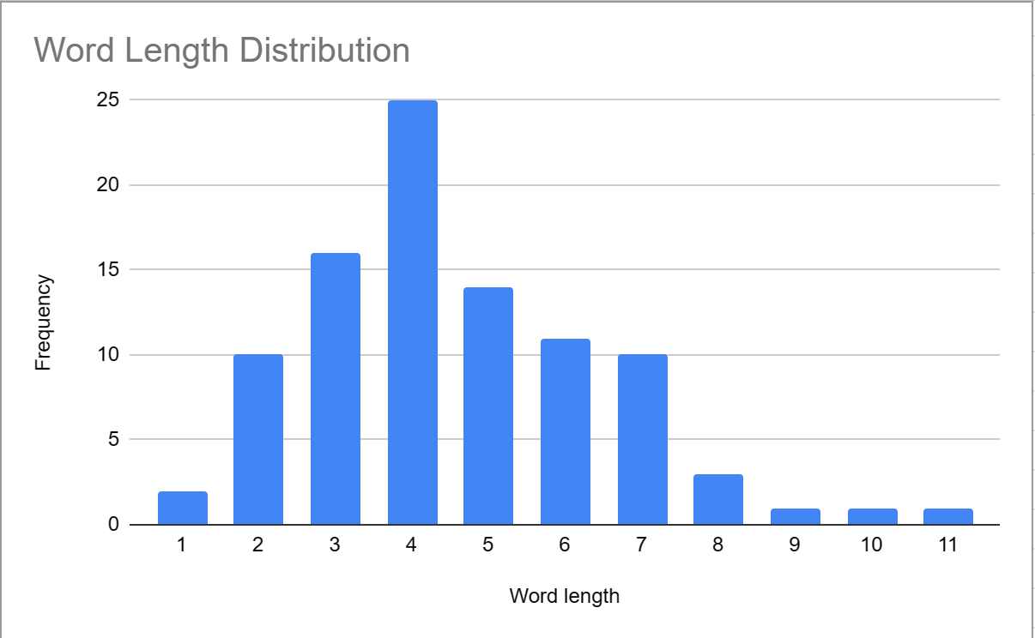

Slide 8
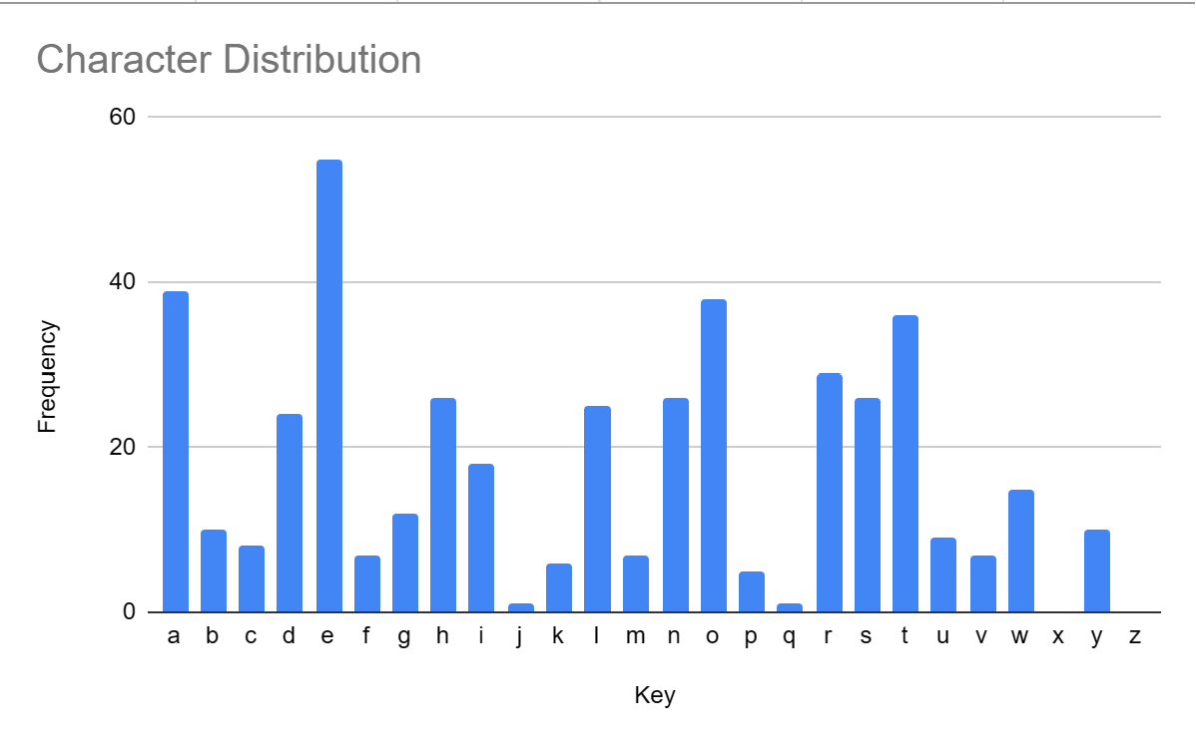

Slide 9
QBF.txt
Unique words: 8
Source: “The quick brown fox jumps over the lazy dog.”

Slide 10
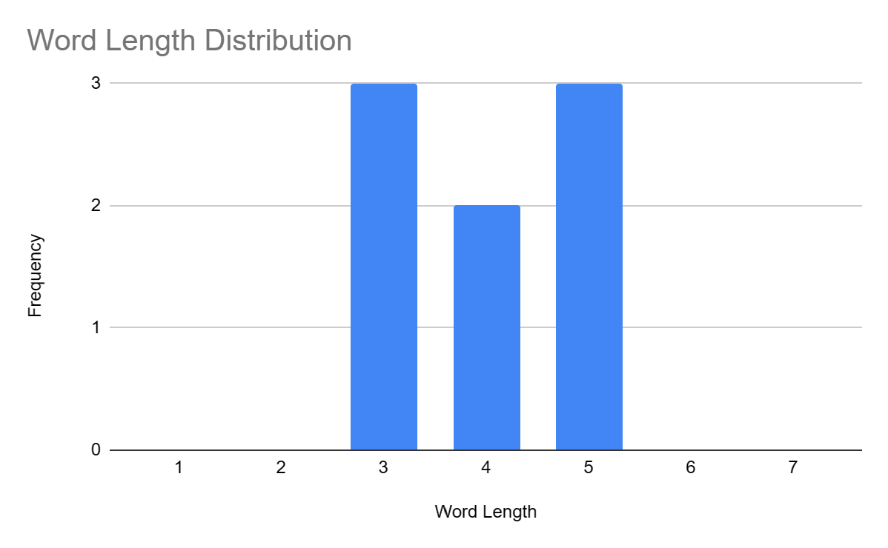

Slide 11
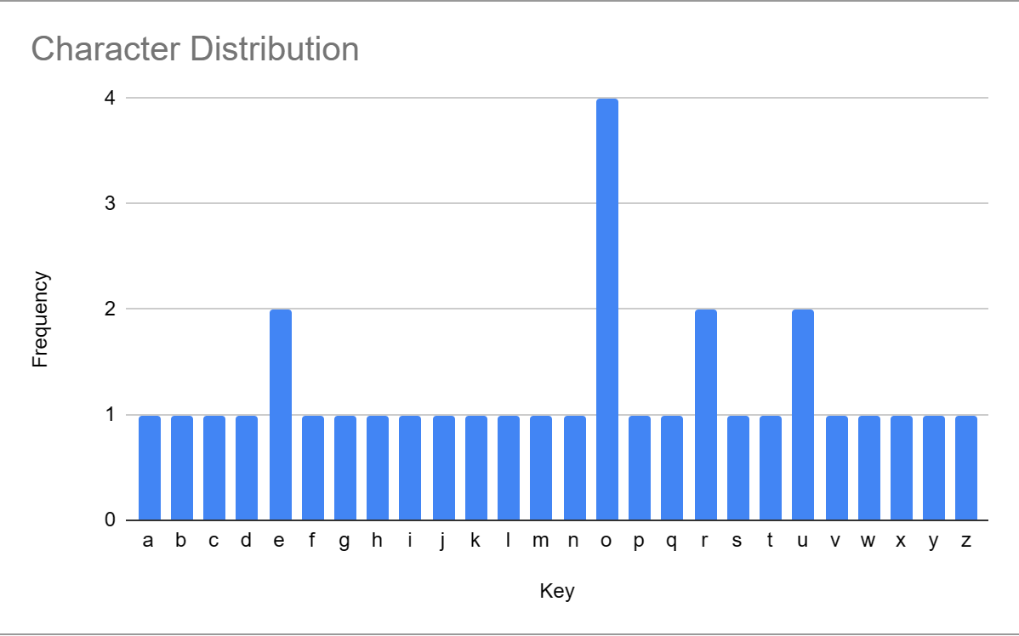

Slide 12
Jumps.txt
Unique words: 1
Source: “jumps”

Slide 13
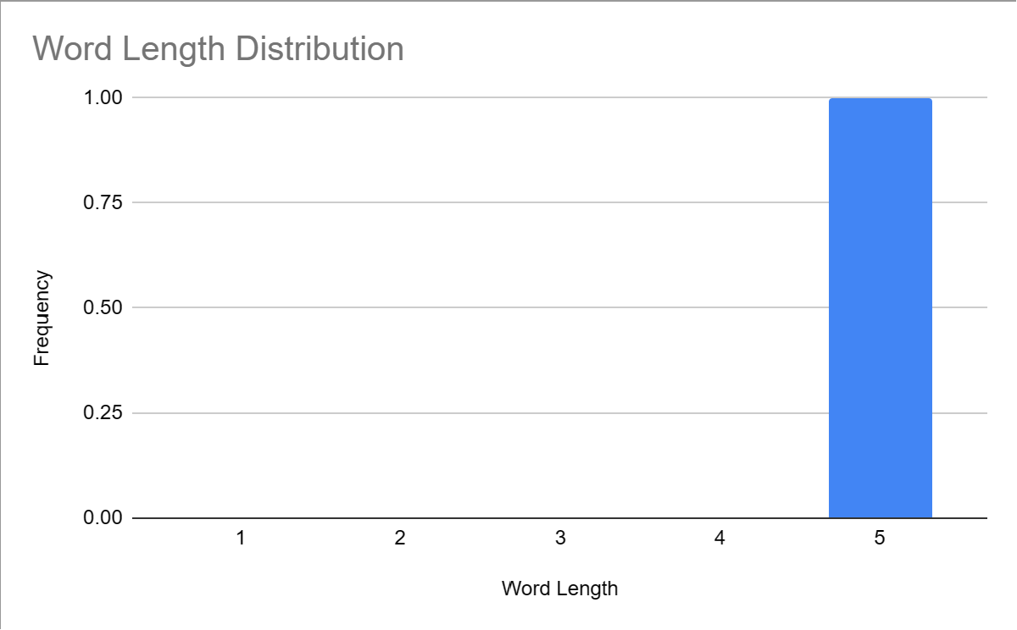

Slide 14
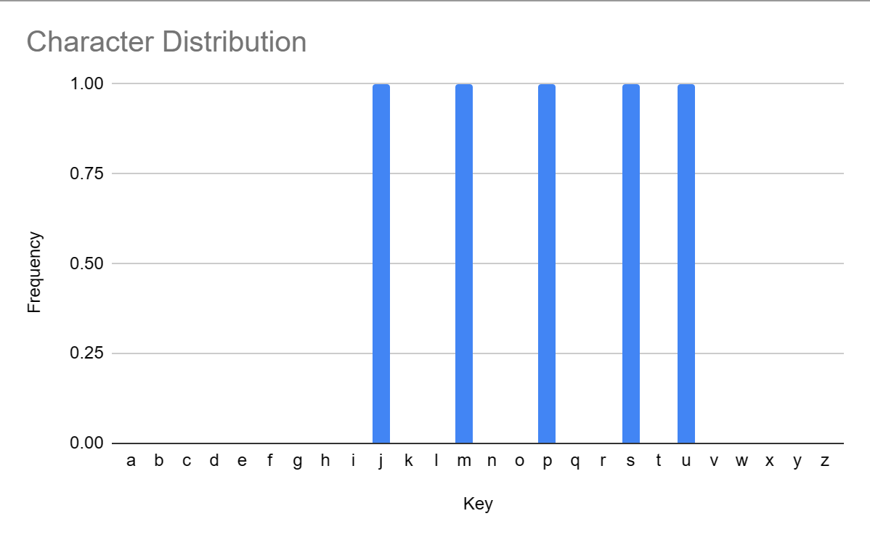

Slide 15
Results
Manhattan Distance

Slide 16
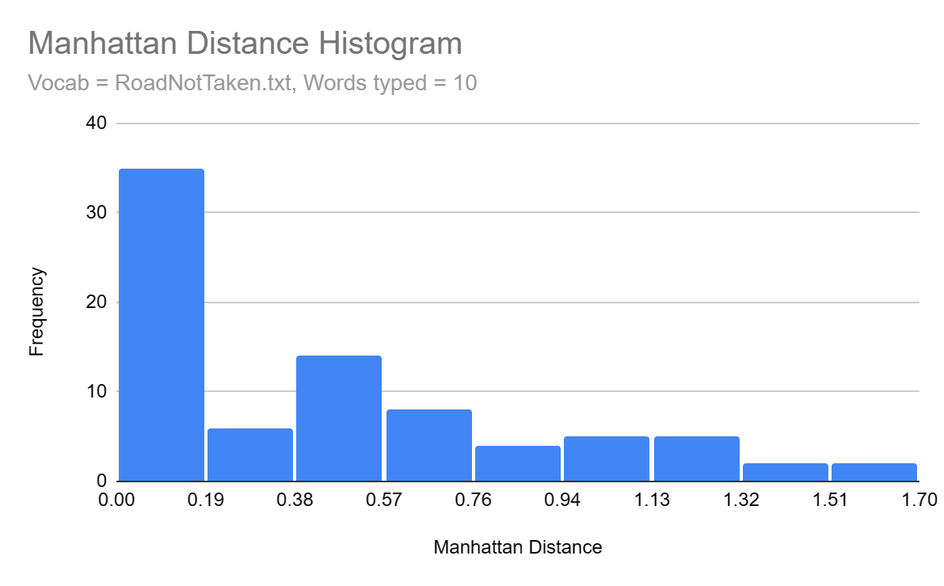

Slide 17
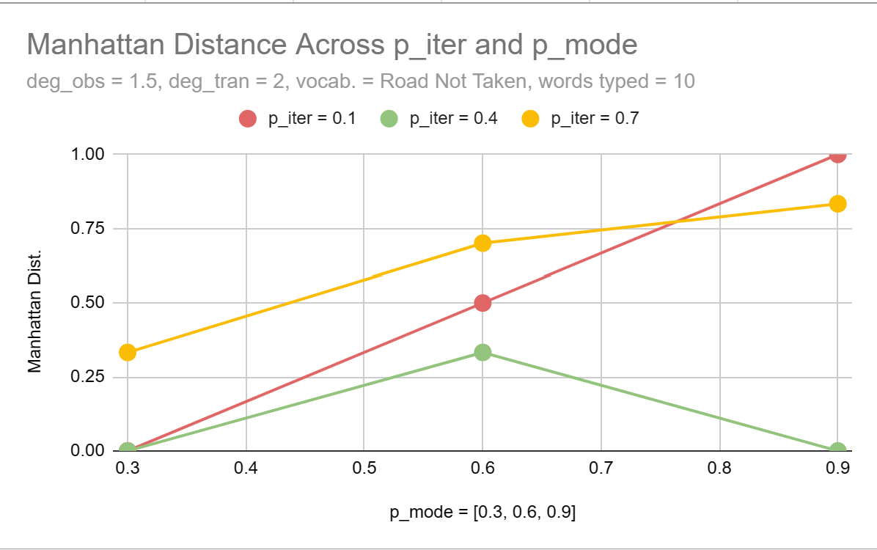
Trend observed? No

Slide 18
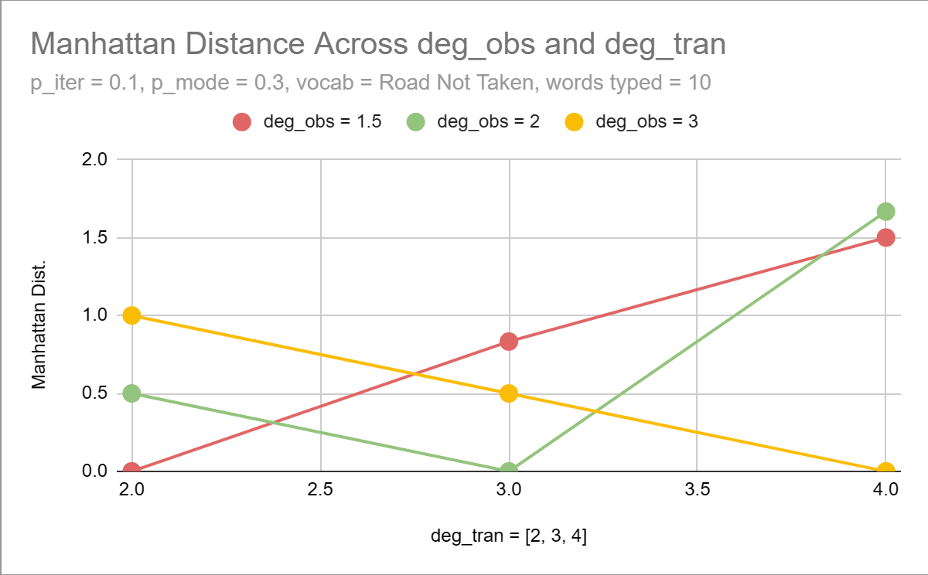
Trend observed? No

Slide 19
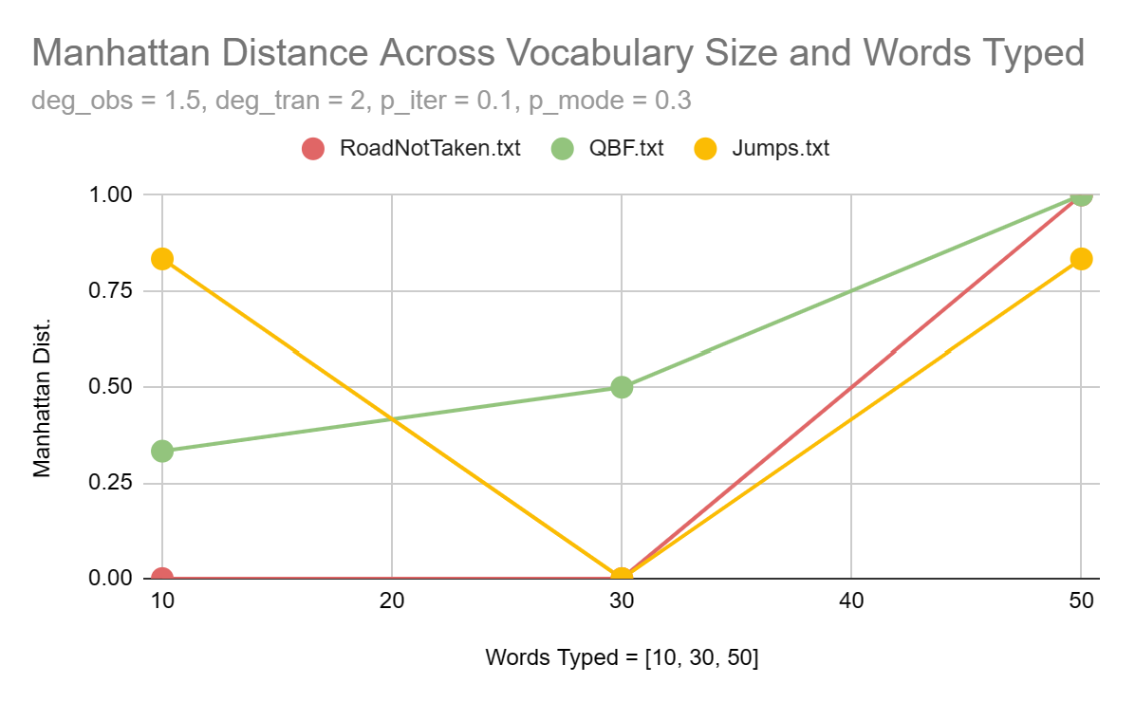
Trend observed? No

Slide 20
Conclusion
The vast majority (88.89% when the vocabulary is RNT and there are 10 words typed) of most likely author parameters are within 1.13 Manhattan distance unit of the true author’s parameters.
An author’s typing behavior–represented by deg_obs, deg_tran, p_iter, and p_mode–does NOT appear to affect accuracy recognition.
Vocabulary size and number of words the author types do NOT appear to affect accuracy recognition.

Slide 21
Results
% Correct Predictions

Slide 22
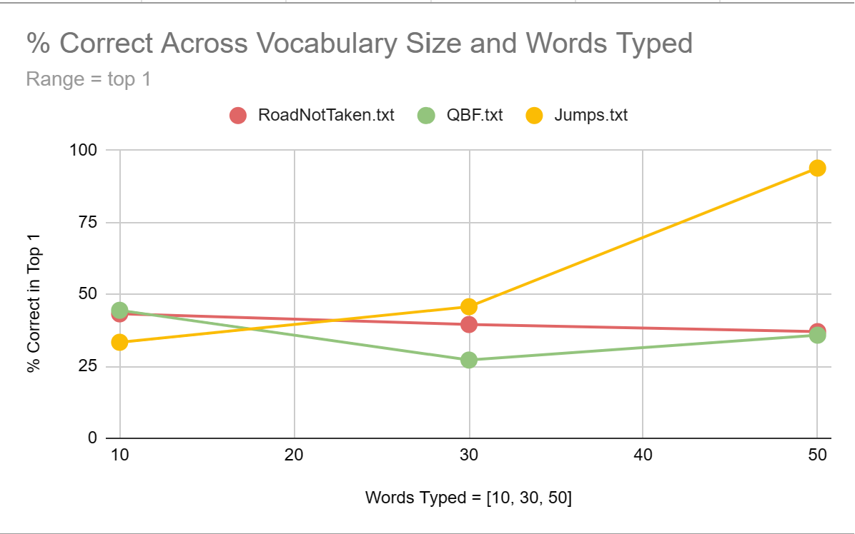
Trend observed? No

Slide 23
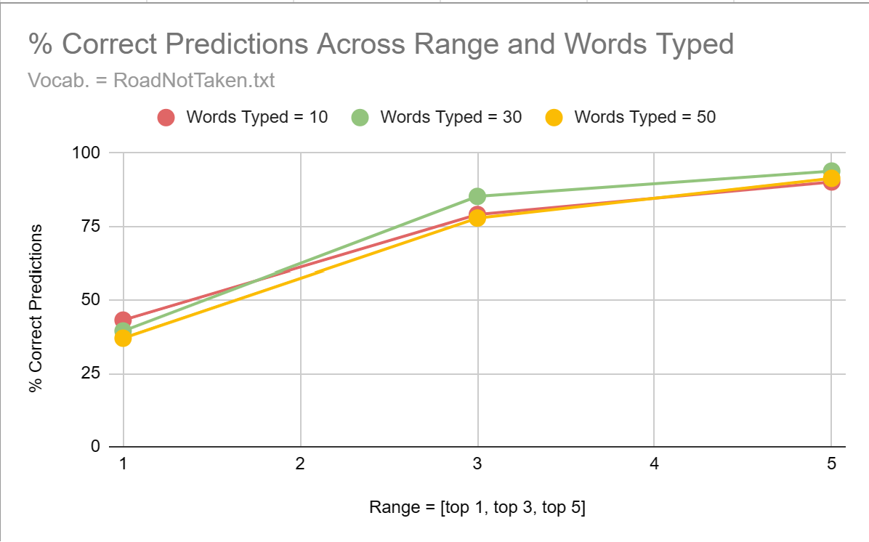
Trend observed? Yes

Slide 24
Avg % Increase in Correct Predictions Across Vocabularies
RoadNotTaken.txt
Top 1 - Top 3: 102.83%
Top 3 - Top 5: 13.89%
QBF.txt
Top 1 - Top 3: 119.16%
Top 3 - Top 5: 22.76%
Jumps.txt
Top 1 - Top 3: 93.74%
Top 3 - Top 5: 14.48%

Slide 25
Avg % Increase in Correct Predictions Across Words Typed
10 Words Typed
Top 1 - Top 3: 96.14%
Top 3 - Top 5: 16.47%
30 Words Typed
Top 1 - Top 3: 117.37%
Top 3 - Top 5: 18.16%
50 Words Typed
Top 1 - Top 3: 102.21%
Top 3 - Top 5: 14.84%

Slide 26
Conclusion
As the range of observation increases from the top 1 to top 3 most likely authors, the percent of correct predictions consistently doubles. When the range increases from the top 3 to top 5 most likely authors, the percent of correct predictions increases by only 10-20%.
Vocabulary size and number of words typed do NOT appear to affect the rate of increase significantly.

